Slide 1
MATLAB ASSIGNMENT GROUP 8
ASSIGNMENT 4

Slide 2
Questions 1 and 2
From the assignment of numerical methods, make equivalent code based on recursive programming
Use the concepts of recursive and dynamic programming to solve the different following problems and make drafts to compare there computation time?
The knapsack problem
Fibonacci functions

Slide 3
Numerical methods considered for recursive programming
Secant method
Newton Raphson method
Euler method
Huen method

Slide 4
Functions considered under recursive programming
Fibonacci functions
Knapsack functions
Computational times

Slide 5
MATLAB code based on recursive programming
% recursive_numerical_methods
% - Recursive root-finders: bisection, false-position, Newton-Raphson, secant
% - Knapsack: naive recursive and memoized DP
% - Fibonacci: naive recursive, memoized recursive, iterative DP
% - Time comparisons and plots

Slide 6
Matlab code
clear; close all; clc;
%% world problem : projectile motion root
v0 = 20; g = 9.81;
f = @(t) v0.*t - 0.5.*g.*t.^2;
df = @(t) v0 - g.*t; % derivative for Newton-Raphson
t_exact = 2*v0/g; % analytical impact time
% Root-search interval and tolerances
a = 0; b = 5;
tol = 1e-8;
maxRecDepth = 1000; % recursion safety

Slide 7
Matlab code
%% Recursive root finders
% Wrapper functions that measure time and call recursive implementations.
% 1) Recursive Bisection
tic; [root_bis, iter_bis] = recursive_bisection(f, a, b, tol, 0, maxRecDepth); time_bis = toc;
% 2) Recursive False Position (Regula-Falsi)
tic; [root_false, iter_false] = recursive_false_position(f, a, b, tol, 0, maxRecDepth); time_false = toc;
% 3) Recursive Newton-Raphson (recursion on iterations)
x0_nr = 2; tic; [root_newton, iter_newton] = recursive_newton(f, df, x0_nr, tol, 0, maxRecDepth); time_newton = toc;

Slide 8
Matlab code
% 4) Recursive Secant
x0_s = 0.1; x1_s = 4.5; tic; [root_secant, iter_secant] = recursive_secant(f, x0_s, x1_s, tol, 0, maxRecDepth); time_secant = toc;
fprintf('Root-finding results (exact t = %.8f):\n', t_exact);
fprintf('Bisection: root=%.10f, iter=%d, time=%.5e\n', root_bis, iter_bis, time_bis);
fprintf('FalsePos: root=%.10f, iter=%d, time=%.5e\n', root_false, iter_false, time_false);
fprintf('Newton: root=%.10f, iter=%d, time=%.5e\n', root_newton, iter_newton, time_newton);
fprintf('Secant: root=%.10f, iter=%d, time=%.5e\n\n', root_secant, iter_secant, time_secant);
%% Plot root-finder computation times
methods = {'Bisection','False Position','Newton-Raphson','Secant'};
times = [time_bis, time_false, time_newton, time_secant];

Slide 9
Matlab code
figure('Name','Root-finder times','NumberTitle','off');
bar(categorical(methods), times);
ylabel('Time (s)');
title('Computation times (recursive implementations)');
grid on;
%% Recursive ODE solvers (single-step recursion)
% Solve dy/dt = -2*y with y(0)=1 on [0,2] for comparison with analytic solution y = exp(-2t)
ode_f = @(t,y) -2*y;
t0 = 0; tf = 2; N = 200; h = (tf - t0)/N;
t_vec = t0:h:tf;
y_exact = exp(-2.*t_vec);

Slide 10
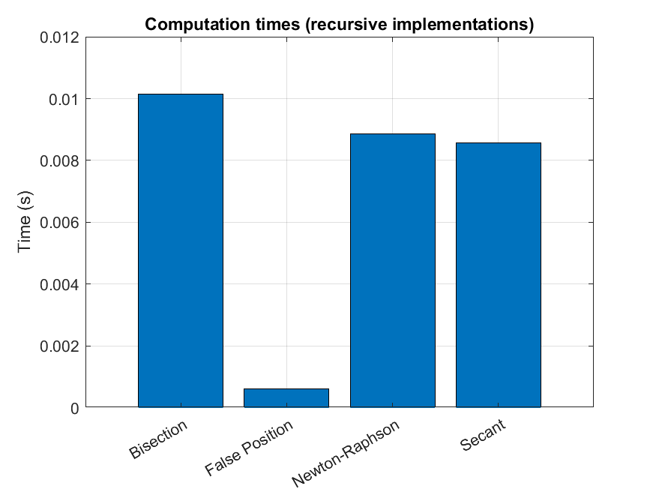
Computational times chart

Slide 11
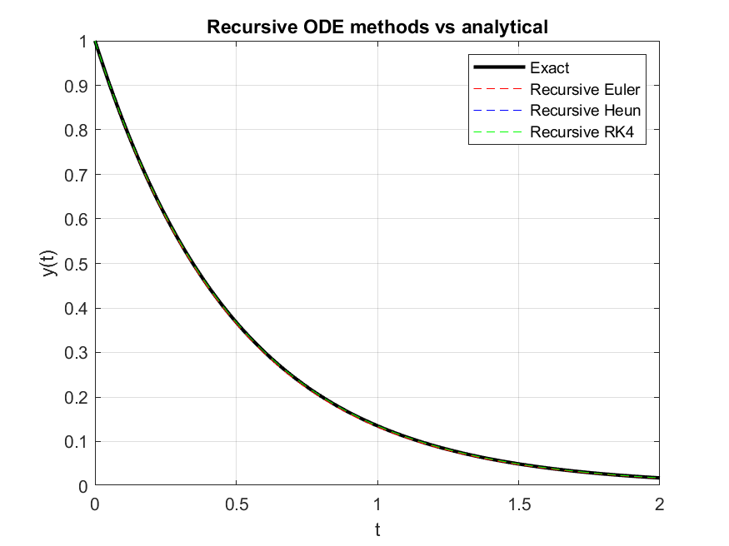
Recursive ODE methods Vs analytical

Slide 12
Matlab code
% Euler (recursive)
tic; y_euler = zeros(size(t_vec)); y_euler(1) = 1;
y_euler = recursive_euler_step(ode_f, t_vec, y_euler, 1, h); time_euler = toc;
% Heun (recursive)
tic; y_heun = zeros(size(t_vec)); y_heun(1) = 1;
y_heun = recursive_heun_step(ode_f, t_vec, y_heun, 1, h); time_heun = toc;
% RK4 (recursive)
tic; y_rk4 = zeros(size(t_vec)); y_rk4(1) = 1;
y_rk4 = recursive_rk4_step(ode_f, t_vec, y_rk4, 1, h); time_rk4 = toc;
fprintf('ODE solver timings:\nEuler: %.5e, Heun: %.5e, RK4: %.5e\n\n', time_euler, time_heun, time_rk4);

Slide 13
Matlab code
% Plot ODE results
figure('Name','ODE solvers vs exact','NumberTitle','off');
plot(t_vec, y_exact, 'k-', 'LineWidth', 2); hold on;
plot(t_vec, y_euler, '--r');
plot(t_vec, y_heun, '--b');
plot(t_vec, y_rk4, '--g');
legend('Exact', 'Recursive Euler', 'Recursive Heun', 'Recursive RK4','Location','northeast');
xlabel('t'); ylabel('y(t)'); title('Recursive ODE methods vs analytical');
grid on;
% Bar times
figure('Name','ODE times','NumberTitle','off');
bar(categorical({'Euler','Heun','RK4'}), [time_euler,time_heun,time_rk4]);
ylabel('Time (s)'); title('ODE recursive integrators time (N=200)'); grid on;

Slide 14
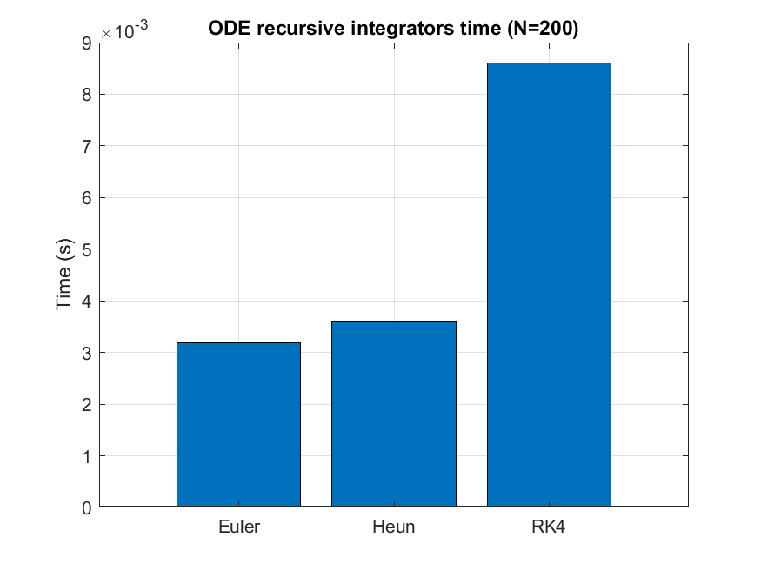
ODE recursive integrators chart

Slide 15
Matlab code
% Display times
disp(table(Ns', times_fib_naive', times_fib_memo', times_fib_iter', ...
'VariableNames', {'n','Time_Naive','Time_Memo','Time_Iter'}));
% Plot times (log scale for clarity)
figure('Name','Fibonacci computation times','NumberTitle','off');
semilogy(Ns, times_fib_naive, '-o', 'LineWidth', 1.5); hold on;
semilogy(Ns, times_fib_memo, '-o', 'LineWidth', 1.5);
semilogy(Ns, times_fib_iter, '-o', 'LineWidth', 1.5);
legend('Naive recursion','Memoized recursion','Iterative DP','Location','northwest');
xlabel('n'); ylabel('Time (s) [log scale]'); title('Fibonacci: naive vs memo vs iterative DP'); grid on;

Slide 16
Matlab code
%% Save figures
%to save figures to PNG files
saveas(figure(1),'root_finder_times.png');
saveas(figure(2),'ode_vs_exact.png');
saveas(figure(3),'ode_times.png');
saveas(figure(4),'knapsack_times.png');
saveas(figure(5),'fibonacci_times.png');

Slide 17
Knapsack function matlab code
%% Knapsack: recursive vs memoized DP
% Example knapsack instance (small-to-medium size for demonstration)
values = [60, 100, 120, 90, 50]; % values
weights = [10, 20, 30, 40, 10]; % weights
W = 50; % capacity
n = length(values);
% 1) Naive recursive (note: exponential time) -- measure time for small n only
tic;
[bestVal_rec, ~] = knapsack_recursive(n, W, weights, values);
time_knap_rec = toc;

Slide 18
Knapsack function matlab code
% 2) Memoized DP (top-down)
tic;
memo = -ones(n+1, W+1); % initialize with -1 meaning unknown
[bestVal_mem, memo_used] = knapsack_memo(n, W, weights, values, memo);
time_knap_memo = toc;
% 3) Bottom-up DP (iterative) for verification and faster time
tic;
bestVal_dp = knapsack_dp(weights, values, W);
time_knap_dp = toc;

Slide 19
Knapsack function matlab code
fprintf('Knapsack results (W=%d, n=%d):\n', W, n);
fprintf('Naive recursion: best=%.2f, time=%.5e\n', bestVal_rec, time_knap_rec);
fprintf('Memoized DP: best=%.2f, time=%.5e\n', bestVal_mem, time_knap_memo);
fprintf('Bottom-up DP: best=%.2f, time=%.5e\n\n', bestVal_dp, time_knap_dp);
% Plot knapsack times
figure('Name','Knapsack computation times','NumberTitle','off');
bar(categorical({'Recursive','Memoized','Bottom-up DP'}), [time_knap_rec, time_knap_memo, time_knap_dp]);
ylabel('Time (s)'); title('Knapsack methods timing'); grid on;

Slide 20
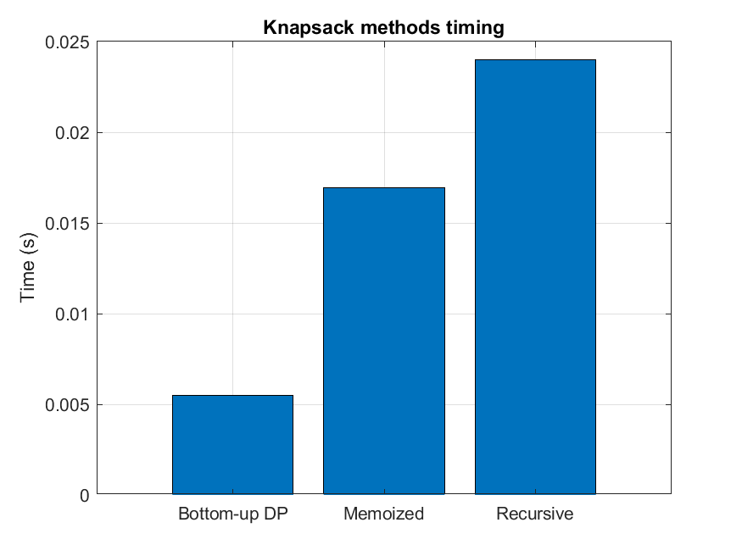

Slide 21
Fibonnacci function matlab code
%% Fibonacci: naive vs memo vs iterative DP (timing & scaling)
% We'll measure for a range of n to show scaling
Ns = [5, 10, 15, 20, 25, 30]; % naive recursion becomes slow quickly (avoid >30)
times_fib_naive = zeros(size(Ns));
times_fib_memo = zeros(size(Ns));
times_fib_iter = zeros(size(Ns));
for idx = 1:length(Ns)
m = Ns(idx);
% naive recursion (may be slow for m>30)
tic; fn = fibonacci_recursive(m); times_fib_naive(idx) = toc;
% memoized recursive
tic; fm = fibonacci_memo(m); times_fib_memo(idx) = toc;

Slide 22
Fibonnacci function matlab code
% iterative DP
tic; fi = fibonacci_iter(m); times_fib_iter(idx) = toc;
end
% Display times
disp(table(Ns', times_fib_naive', times_fib_memo', times_fib_iter', ...
'VariableNames', {'n','Time_Naive','Time_Memo','Time_Iter'}));
% Plot times (log scale for clarity)
figure('Name','Fibonacci computation times','NumberTitle','off');
semilogy(Ns, times_fib_naive, '-o', 'LineWidth', 1.5); hold on;
semilogy(Ns, times_fib_memo, '-o', 'LineWidth', 1.5);
semilogy(Ns, times_fib_iter, '-o', 'LineWidth', 1.5);

Slide 23
Fibonnacci function matlab code
legend('Naive recursion','Memoized recursion','Iterative DP','Location','northwest');
xlabel('n'); ylabel('Time (s) [log scale]'); title('Fibonacci: naive vs memo vs iterative DP'); grid on;
%% Save figures
%to save figures to PNG files
saveas(figure(1),'root_finder_times.png');
saveas(figure(2),'ode_vs_exact.png');
saveas(figure(3),'ode_times.png');
saveas(figure(4),'knapsack_times.png');
saveas(figure(5),'fibonacci_times.png');

Slide 24
